Slide 1
Predicting Home Sales Values

Slide 2
We Can Reliably Predict Sale Value With Limited Data
All we need to come up with a powerful model is:
Assessed Value
Month of Sale
Location (City)
Residential Type (Single Family vs. Multi Family)

Slide 3
Model
The successful model was a random forest model using the relatively small dataset mentioned before

Slide 4
Metrics
Our Random Forest model ended up with an R-Squared of 0.8085 which means that the model accounts for over 80% of the variability of the home values

Slide 5
Why Does This Matter?
Typically an R-Squared of over 0.8 is sufficient for being able to make predictions

Slide 6
Could This Be Better?
The model could certainly be improved with more data. Possibly comparable home prices or a breakdown of bedrooms and bathrooms for the house

Slide 7
How Did We Get Here?
In deciding on this model we ran other models using OLS regression as well as Ridge regression. Both of these performed worse than the Random Forest model even when given more variables however.

Slide 8
Why These Variables?
In order to determine which variables to use we analyzed the correlations via a heat map

Slide 9
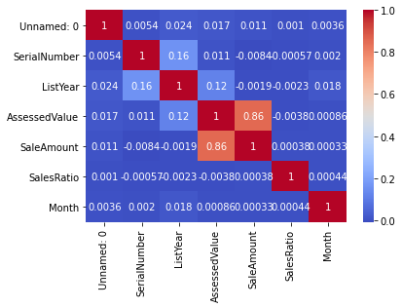
Correlations
As you can see only one pair of columns were highly correlated. We had to experiment with the models to find the other best ones.

Slide 10
Summary
We were able to find a strong model to predict home values
This model doesn’t rely on needing a large amount of data
More variables could help improve model performance

